Slide 1
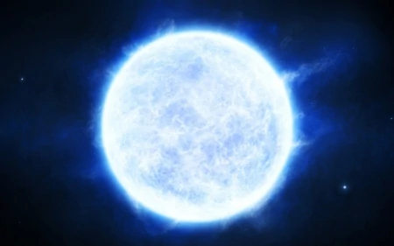
A highly magnetized and rapidly rotating white dwarf as small as the Moon

Slide 2
White Dwarf
Stellar core remnant
High density
Final stadium of a star (not enough mass for neutron star or black hole)
Chandrasekhar limit ~ 1.44
No fusion anymore

Slide 3
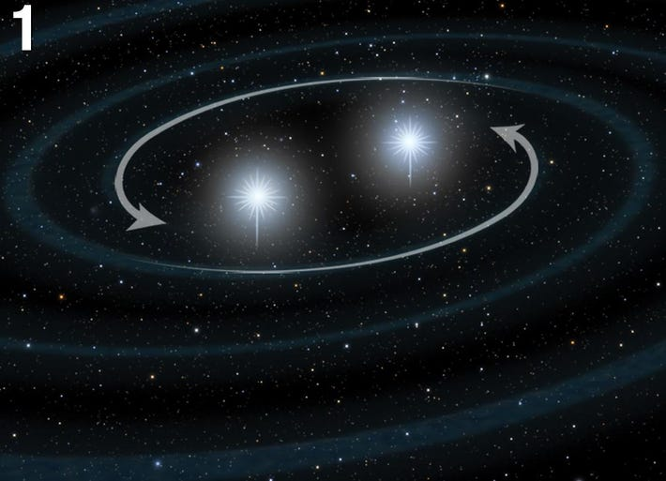
Supernova 1a
or
Massive white dwarf
Conservation of angular momentum

Slide 4
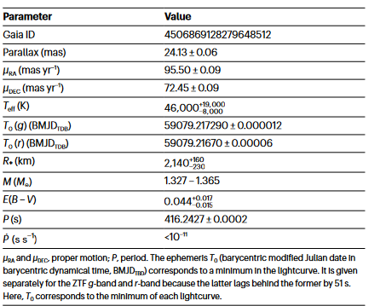
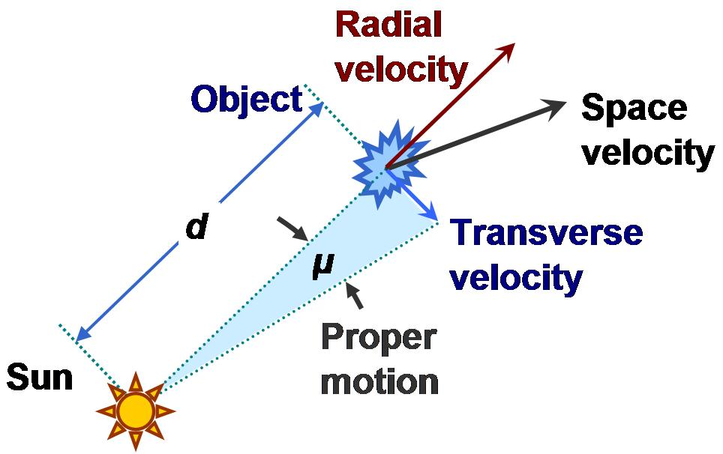
ZTF J190132.9+145808.
Radius 2140km (moon 1,737km)
Period of 6.94 min (usually couple hours)
Magnetic field 600-900 MG
  Comparison 1e+17 G upper limit for neutron stars
Interstellar redding/Extinction

Slide 5
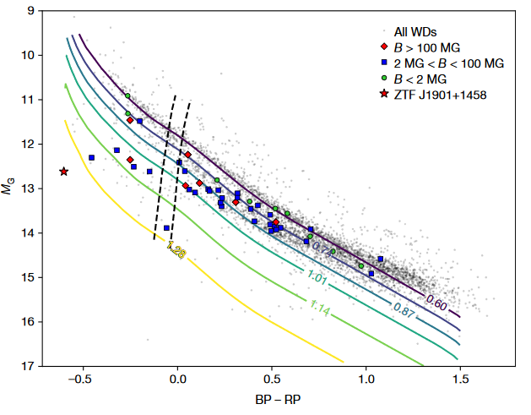
White dwarfs within 100pc from earth

Slide 6
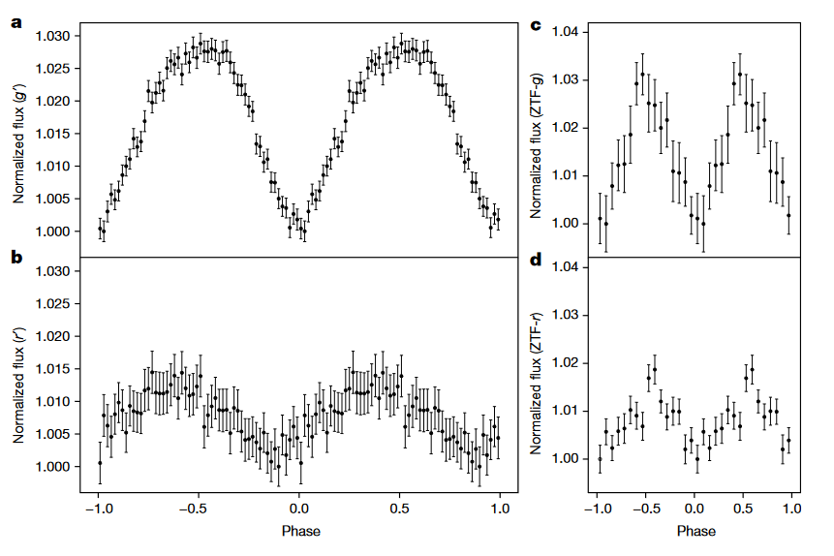
g‘-band
r‘-band

Slide 7
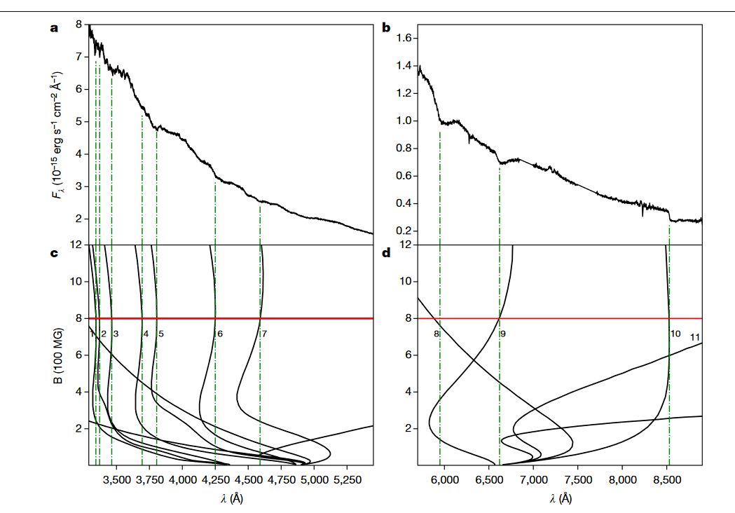

Slide 8
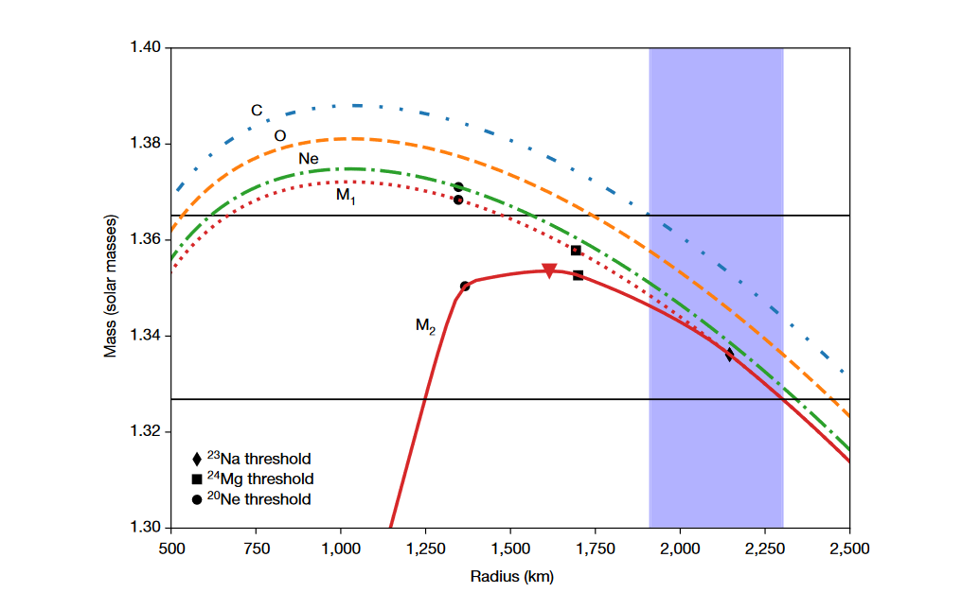
Mass – Radius relation at 46000K for diffrent compositions

Slide 9
Methods
Period
  Combining data from multiple filters
  Shifting g,i-band to match the r-band
  ZTF… short period and blue and faint location

Slide 10
Methods
Magnetic Field
  Low magnetic fields, three Zeemann components in hydrogen transitions
  Above 100 MG magnetic and coulomb comparable
  Absorption features still detectable
  -> ZTF… ~800 MG

Slide 11
Methods
Theoretical mass – radius relation
  Calculated with an equation of state (corrections for Coulomb, relativistic corrections)
  Tolman-Oppenheimer-Volkhoff equation
  -> cooling age between 10 and 100 Myr

